Slide 1

Ruby Language

Slide 2
About today…
Introduction
Installation
Writing first Ruby program

Slide 3
What is Ruby?
Ruby is a dynamic, open-source programming language with a focus on simplicity and productivity
Created by Yukihiro "Matz" Matsumoto in Japan in the mid-1990s
Key Features :
Interpreted language
Object-oriented
Dynamic typing
Automatic memory management

Slide 4
Why Learn Ruby?
Ease of Use
Intuitive and easy-to-read syntax
Flexibility
Suitable for web development, automation, data processing, etc.
Community Support
Large and active community with extensive libraries and frameworks
Applications
Popular in web development (e.g., Ruby on Rails), DevOps (e.g., Chef), and scripting

Slide 5
Ruby vs Other languages
Ruby vs. Python
Both are dynamic and easy to read, but Ruby emphasizes flexibility while Python emphasizes readability
Ruby vs. JavaScript
Ruby is primarily server-side, while JavaScript is used for both client-side and server-side (with Node.js)
Ruby vs. PHP
Ruby offers more elegant syntax and is used with frameworks like Rails, while PHP is widely used for server-side scripting

Slide 6
Prerequisites
Programming Fundamentals
Understanding of variables, loops, conditionals, and functions
Understanding of Object-Oriented Programming (OOP)
Basic concepts like classes, objects, inheritance, and polymorphism

Slide 7
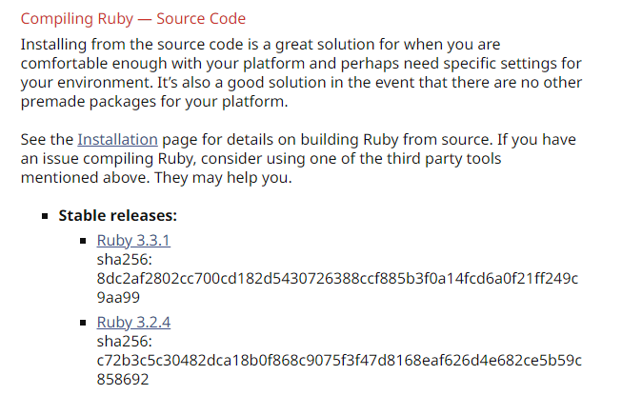
Installing Ruby on Windows
Downloading Ruby Installer
https://www.ruby-lang.org/en/downloads/

Slide 8
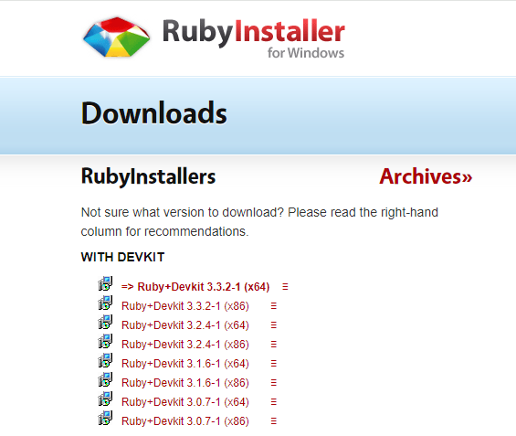

Installing Ruby on Windows
Download Ruby Installer
https://rubyinstaller.org/downloads/

Slide 9
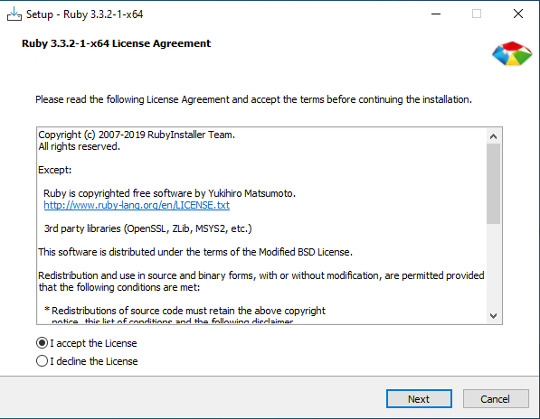

Slide 10
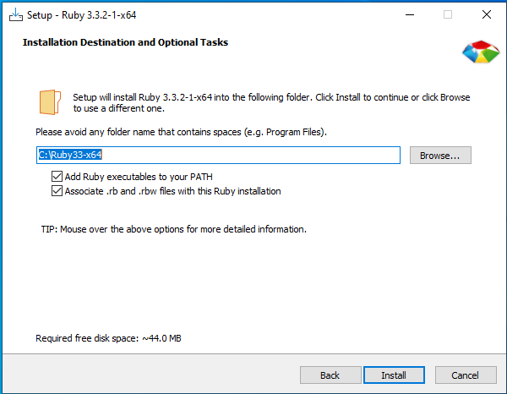

Slide 11
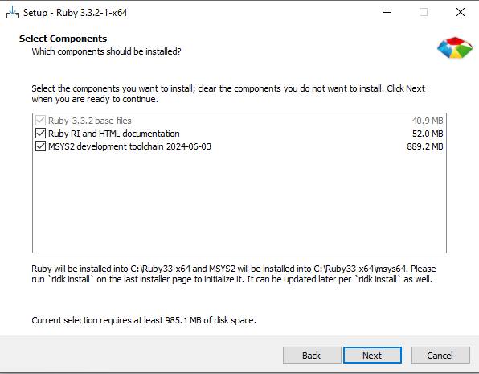

Slide 12
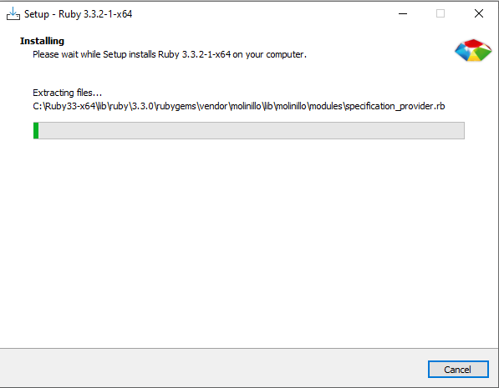

Slide 13

Verifying the Ruby Installation
Check ruby version

Slide 14
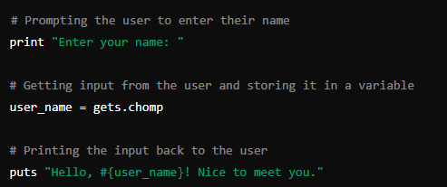

First Ruby Input Program
Create a new file “first.rb”
Type “ruby first.rb” in terminal

